Slide 1
eDocent
Group 5 Final Presentation

Slide 2
Overview
Project Goals
Create an Android application allowing museum patrons to learn more about works of art.
Create a Web application where museum administrators can provide information for the Android app.
Grow as software engineers and learn how to build a quality product as a group.

Slide 3
Overview
Museum & Patrons
Museum Administrators
Interact with our Django web interface, add works of art and museum information
Patrons
Interact with our Android application, find nearby museums, listen to audio clips about the art and scan QR codes to interact with artwork

Slide 4
Requirement Analysis

Slide 5
Requirement Analysis
Functional Requirements
Secure Museum Login
Upload/edit/delete content
Access content through mobile app
Splash page to display museum info
Ability to look through museum collection
Lookup item through QR code

Slide 6
Requirement Analysis
Use Case Diagram
Frontend (Android Application)
One human actor - tourist
Backend (Web Interface)
Museum’s owner actor
eDocent team actor
( The Diagram Next Page)

Slide 7
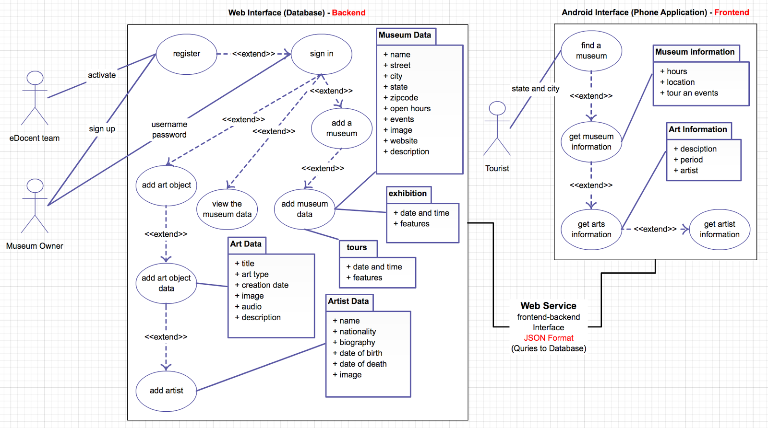

Slide 8
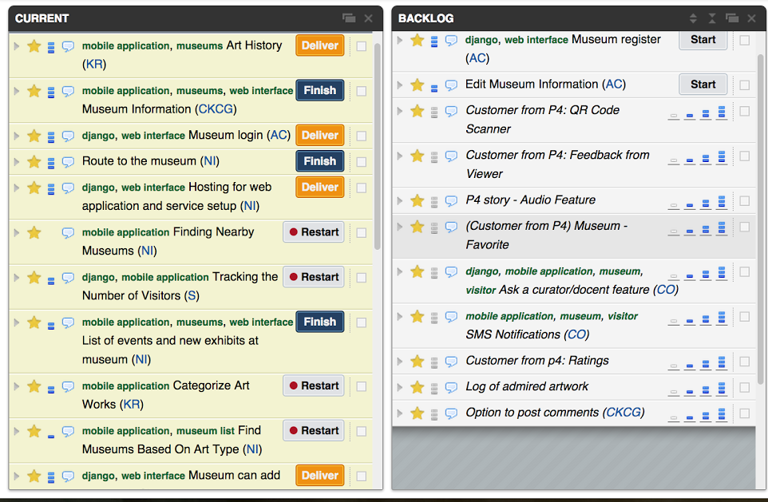
Requirement Analysis
User Stories
Pivotal Tracker
Total number of user stories: 30
Completed: 15
Planned: 18

Slide 9
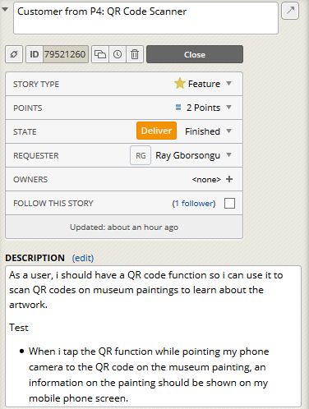
Requirement Analysis
User Stories
Sample
Complete: QR Code
Planned but not completed:
Search by art work type
Example of possible extension:
Feedback/Comment for an
art work

Slide 10

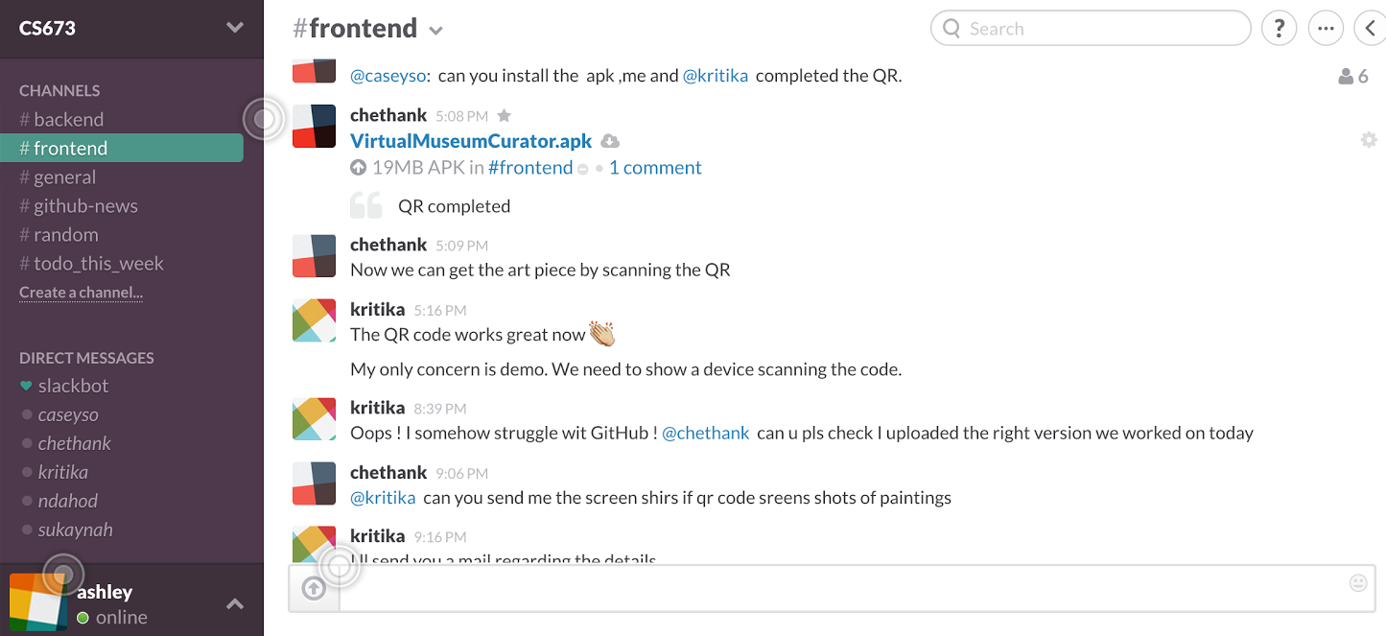
Requirement Analysis
Tracking requirements and changes
Slack - progress shared
Notes:
Slack brings all your communication together in one place. It's real-time messaging, archiving and search for modern teams.
Requirements analysis involves frequent communication with system users to determine specific feature expectations, resolution of conflict or ambiguity in requirements as demanded by the various users or groups of users, avoidance of feature creep and documentation of all aspects of the project development process from start to finish.

Slide 11
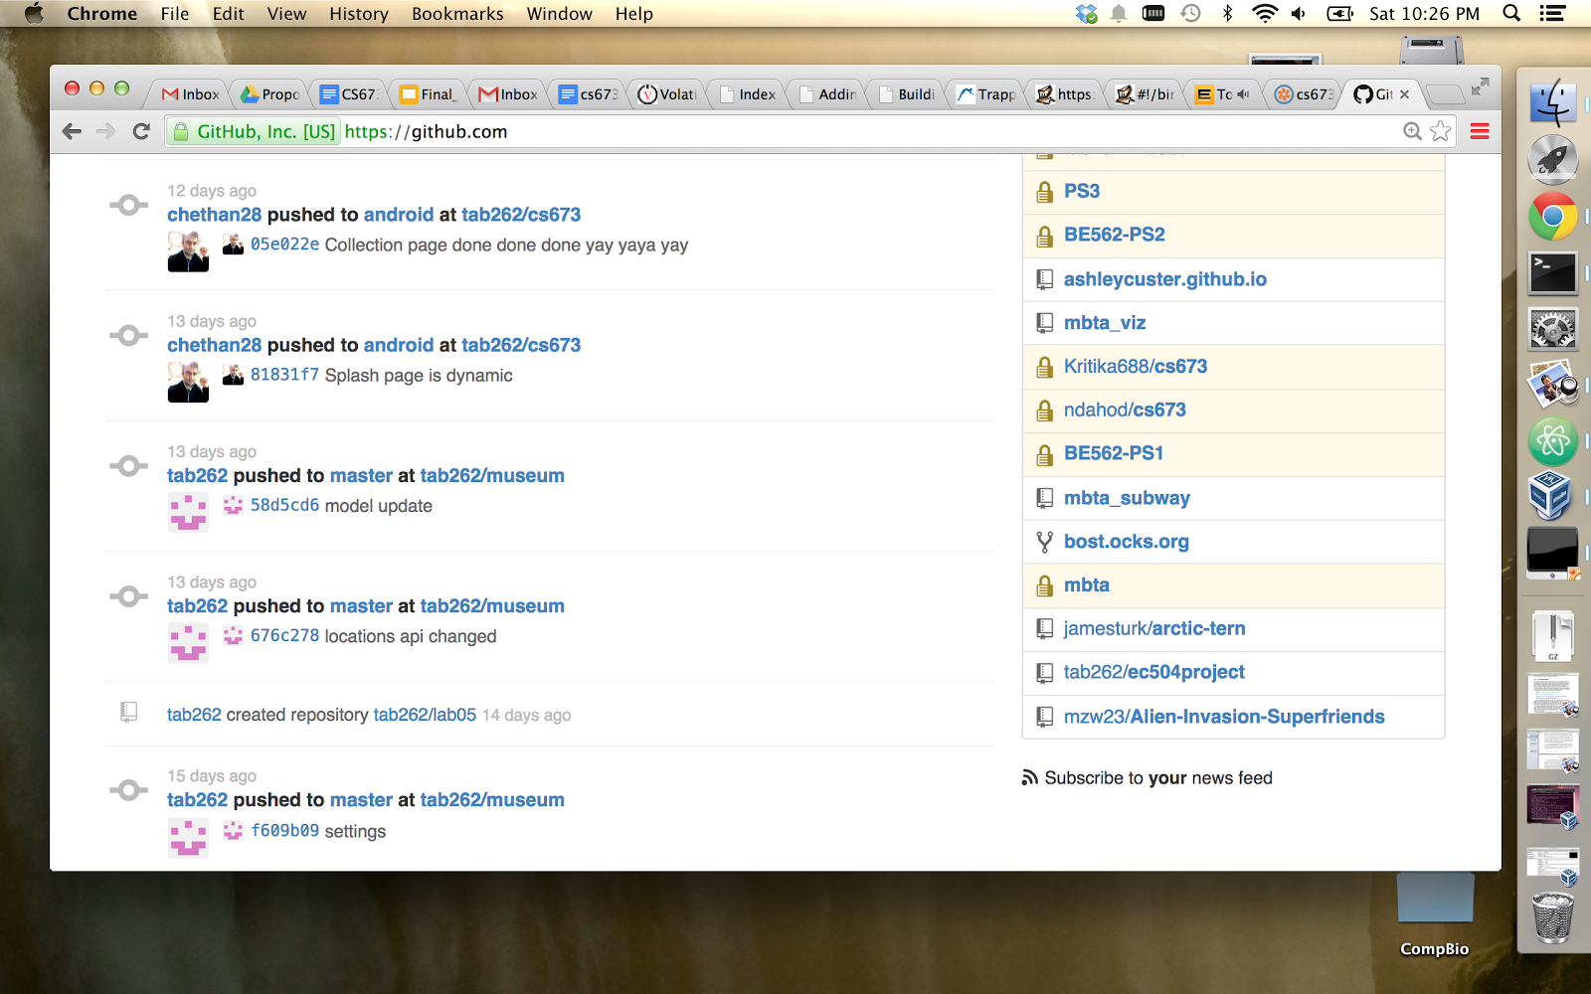
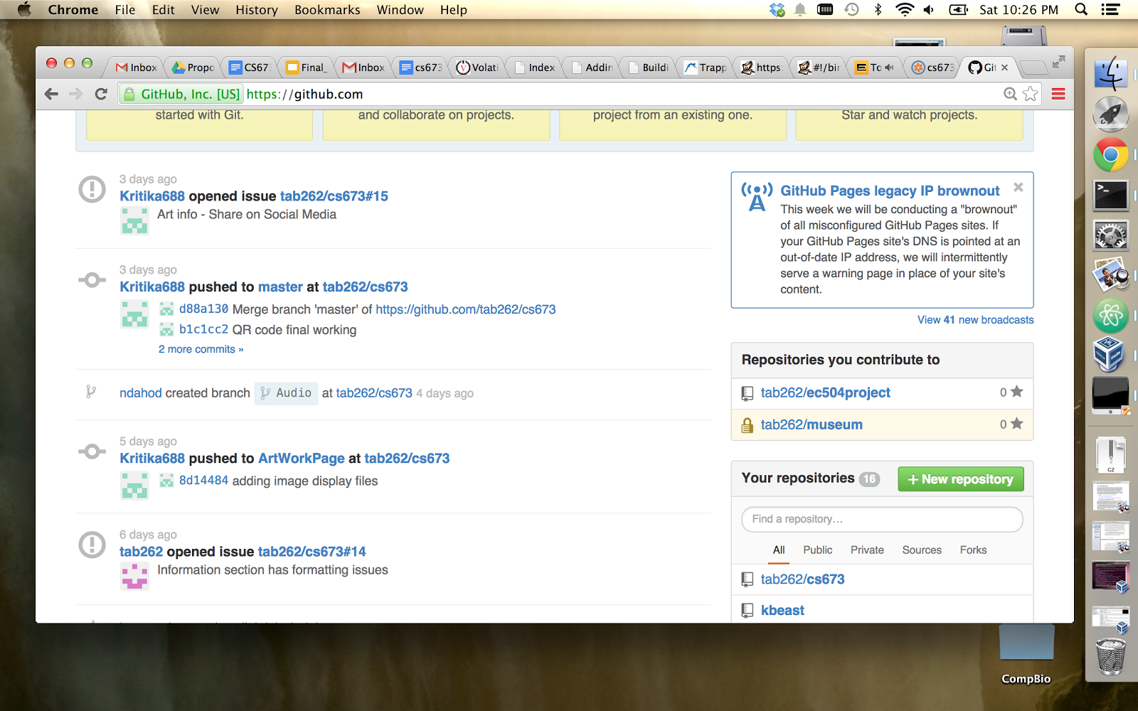
Requirement Analysis
Tracking requirements and changes
GitHub - commit messages

Slide 12
Requirement Analysis
Changes
Requirement changes
Added features: Automatic latitude/longitude calculation from address in Django admin, social media sharing on Android app
How we tracked changes
Introduced in weekly meeting or Slack conversation
Status updated via GitHub commits and Slack discussion

Slide 13
Requirement Analysis
Non-functional requirements
Intuitive museum admin form fields
Museum admin filtering for user-friendly interface
Intuitive user-interface of Android app
Visually pleasing user-interface of Android app
Security
Notes:
(no instructions necessary) - readability/usability

Slide 14
Design

Slide 15
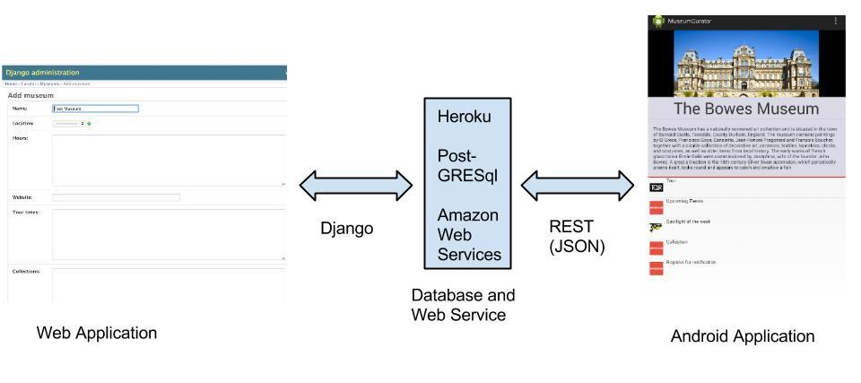
Design
Software Architecture
Notes:
Ashley - software architecture, django/database, api, android application. Android Application: Allows museum patrons to get information about museums and learn more about artwork, artists, and exhibitions. Our projects main mission is to provide an educational and interesting experience to museum visitors. Web Application: Way to get information from museums into our database. The primary role of the web service is to serve as the interface between the web administration interface/database and the Android application. It works by acting as a REST API, allowing the Android application to make HTTP GET requests, where the contents returned are determined by the HTTP URL. The content returned is in the JSON format.

Slide 16
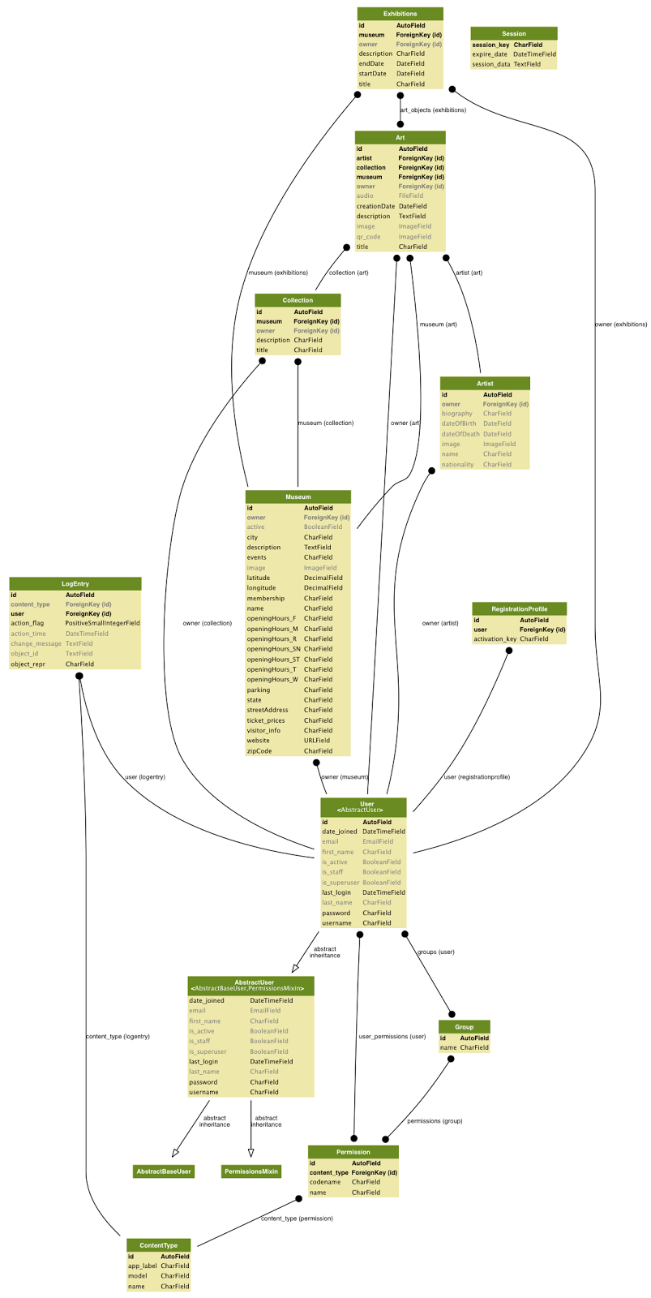
Design
Database Modeling (ER-Diagram)
Museum
Art
Artist
Exhibitions
Collections
Notes:
Entity relationship diagram of our Django models/PostGRESql database tables

Slide 18
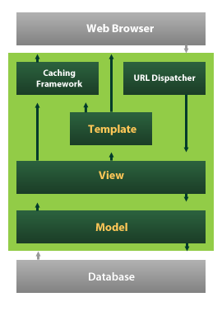
Design - Django MVC
Model - data-access, handled by Django’s database layer
View - selects which data to display and how to display it (handled by views & templates
Controller - delegates to a view depending on user input, handled by the Django framework itself (URLconf)
Notes:
Ashley - django follows MVC pattern closely enough that it can be called an MVC framework. here’s how the M V and C break down in Django…

Slide 19
Design - Django MTV
Model - data access layer, contains everything about the data
Template - presentation layer, how things are displayed
View - business logic layer, bridge between models and templates
Notes:
Ashley - Because the “C” is handled by the framework itself and most of the excitement in Django happens in models, templates and views, Django has been referred to as an MTV framework. In the MTV development pattern…

Slide 20
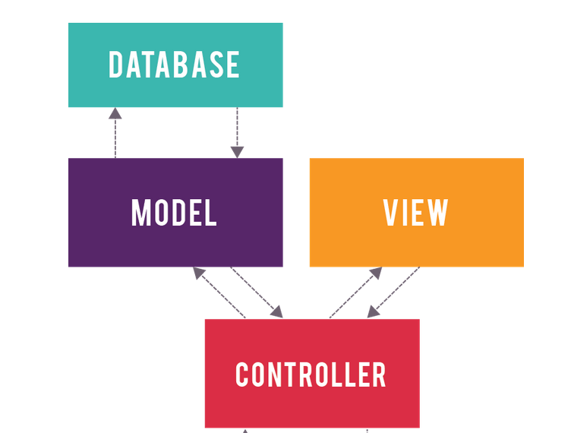
Design - Android MVC
View: Displays the application data to the user and gets data from the user.
Model: Responsible for maintaining the data. It communicates to the database through a RESTful API.
Controller: Intermediary between the View and the Model.

Slide 21
Implementation

Slide 22















Implementation
Tools
Notes:
eclipse, django, selenium, heroku, amazon web services, github, pivotal tracker, slack, google docs, google calendar

Slide 23
Implementation
Challenges
Finding enough time to work on the project and juggle busy schedules.
Experience levels were different.
Working in two groups and understanding the progress in each group.
Adapting to different work styles

Slide 24
Implementation
Web Application
Features:
Museum can login with username and password
Museum can specify museum name, address, tour times, hours open, and more (address automatically converted to lat-lon for Android app’s map feature)
Museum can add works of Art, Artists, and Exhibitions
Museums can only see items associated with their museum

Slide 25
Implementation
Android Application
Features:
User can choose a museum after they input their state and city.
Directed to the museum home page which displays the picture of the museum, the hours, and the address. Users can also scroll through the options of taking a virtual tour, viewing upcoming events, viewing the ‘spotlight of the week,’ collections currently in the museum, events, maps (Google Maps), and the option to receive notifications from the museum.
If the user selects ‘Maps,’ they will be connected to Google Maps and can get directions to the museum.
If you click QR, then you can scan the code and be led to the art piece.
If the user selects ‘Collections,’ they will see a list of all the art pieces in the museum’s collection.

Slide 26
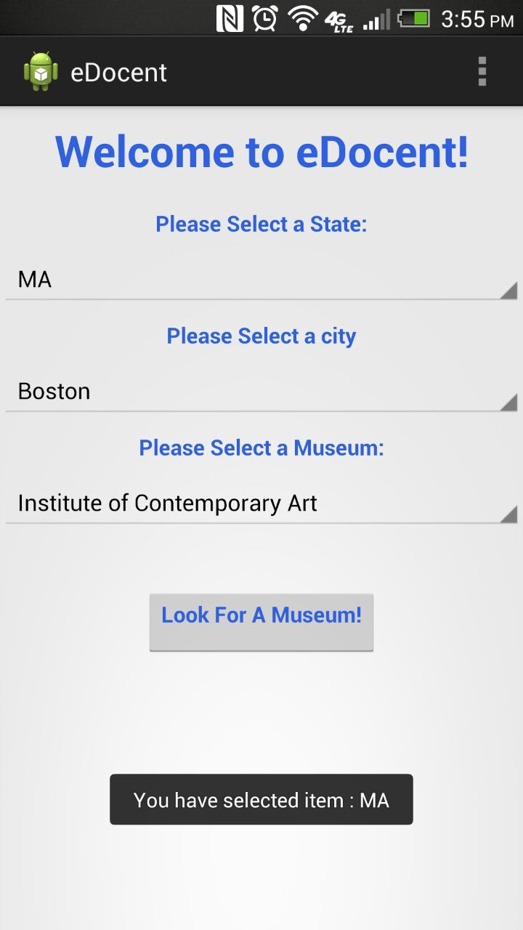
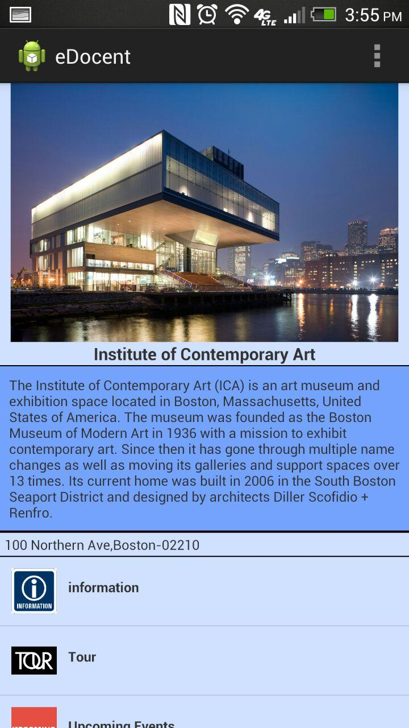
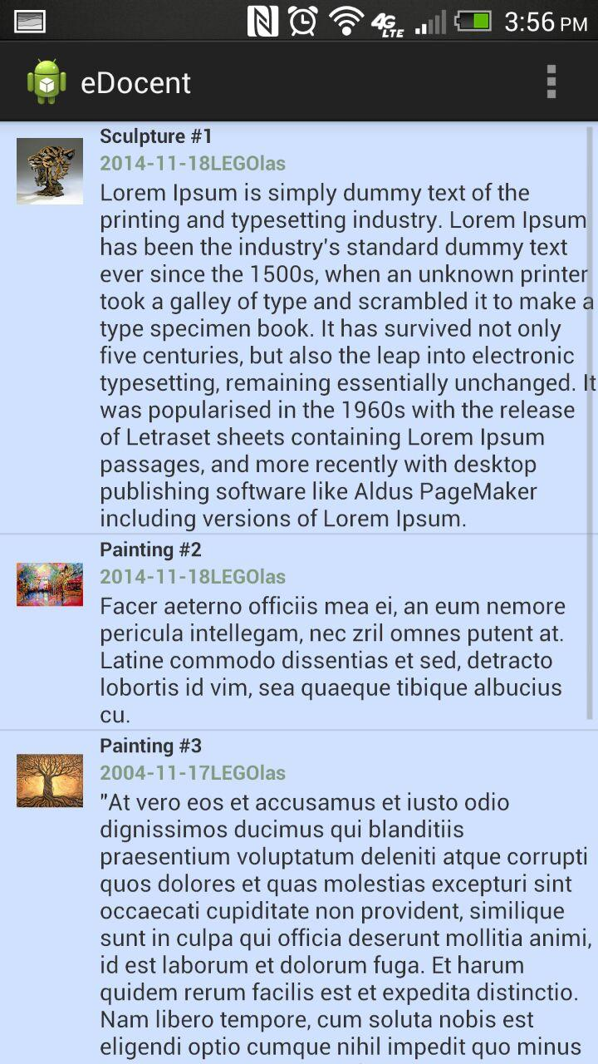
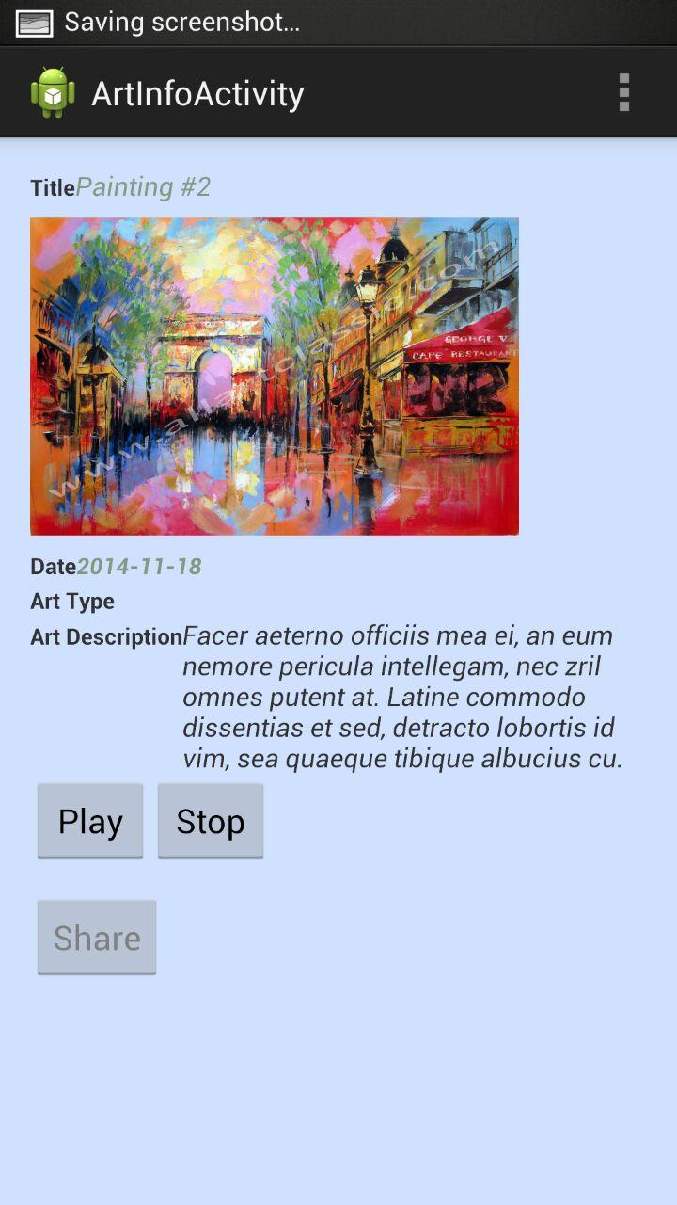
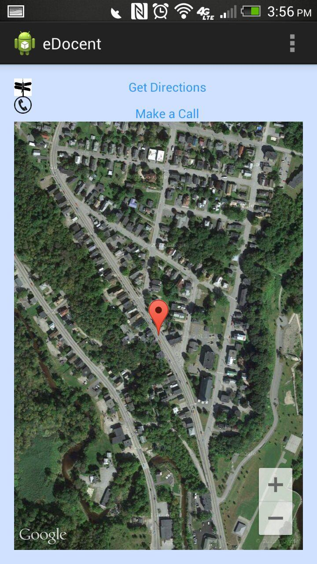
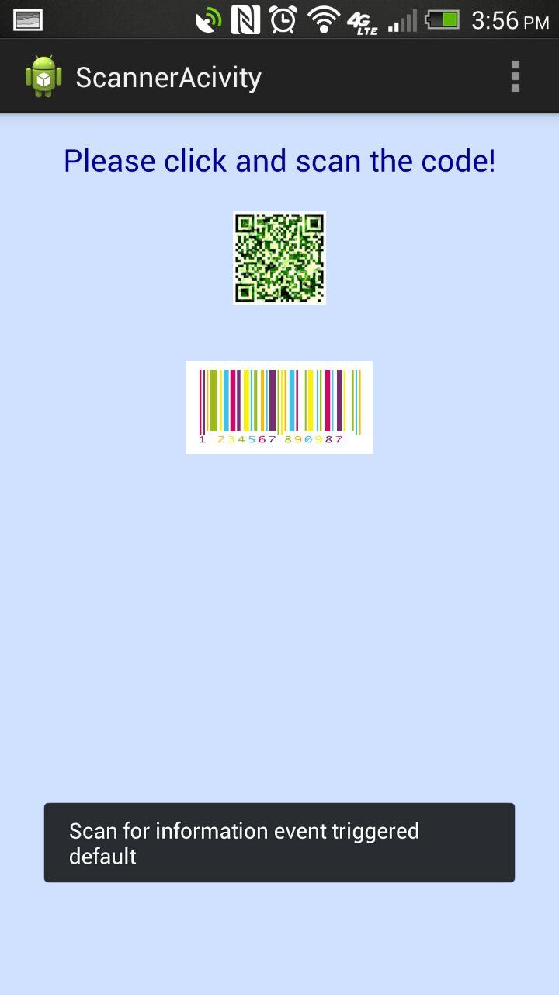
Implementation
Android Application
Features continued:
They can select on an art piece and be led to a page, which displays a larger picture of the art piece, can play an audio clip about the piece, has information about the art piece, and can be shared on social media.

Slide 27
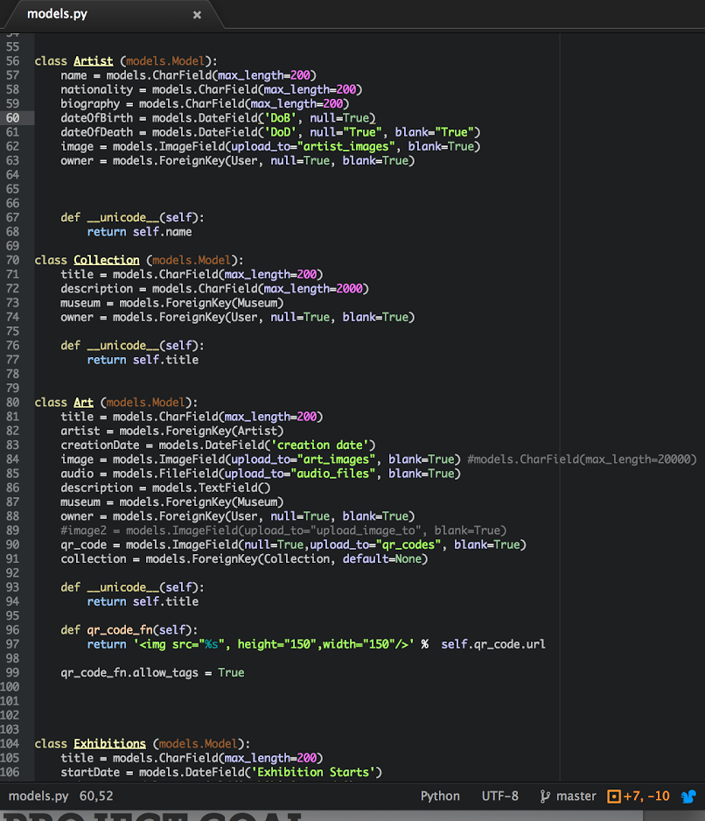
Implementation
Refactoring
Back end:
Bad smell examples:
duplicated code
speculative generality
Notes:
duplicate code: in Collection and Art classes, owner and museum do the same thing, each owner is associated with one museum, so museum alone would be sufficient
speculative generality: both museum and owner were used in these classes in the case that one owner had multiple museums, but that will most likely never happen

Slide 28
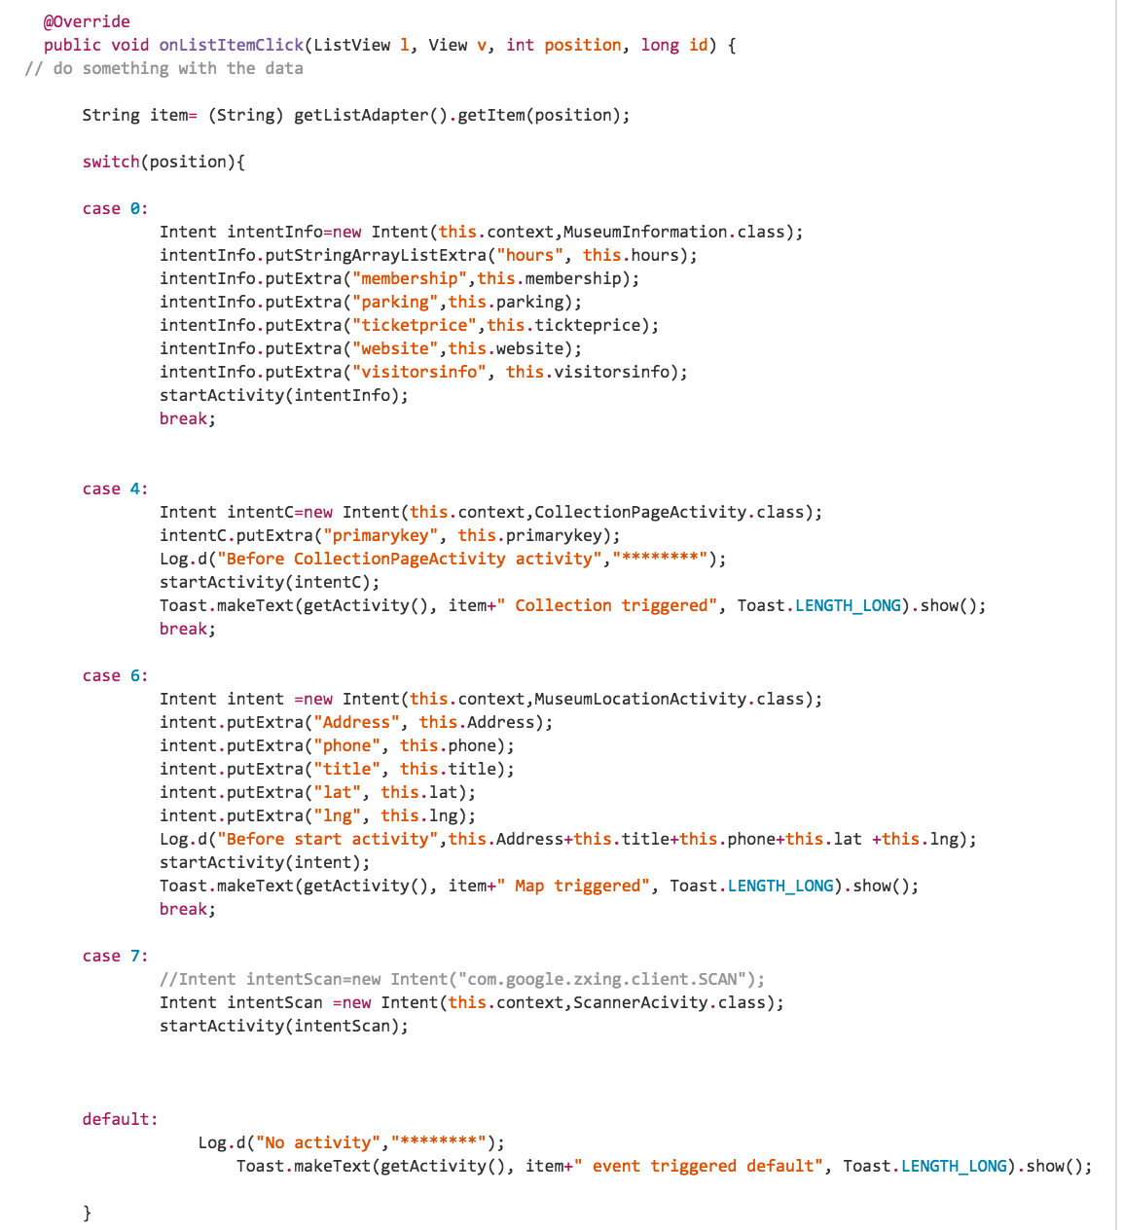
Implementation
Refactoring
Front End:
Bad smells:
Switch statements
Some duplicated code

Slide 29
Testing

Slide 30
Testing - Backend
Backend
Manual
Unit testing
Regression testing
Test driven development

Slide 31
Testing - Frontend
Manual testing
Unit testing
Automation framework
Robotium
Example of Unit Test Code for audio feature:
public void testSplashPage() {
solo.assertCurrentActivity("testing splash page", EDocentSplashActivity.class);
solo.pressSpinnerItem(0, 0);
solo.pressSpinnerItem(1, 0);
solo.pressSpinnerItem(2, 0);
solo.clickOnButton("Look For A Museum!");
}

Slide 32
Project Management

Slide 33
Project Management
Backend Team Contributions:
Ashley:
Django admin developer (models, permissions, user experience)
Coordinator of group calendar, communication tools, planning
Sukaynah:
Designing diagrams (er-diagram, use case diagram)
Registration of new users & resetting password
Casey:
Django admin and REST API developer
Hosting configurations with Heroku and AWS
Testing

Slide 34
Project Management
Frontend Team Contributions:
Chethan:
Splash Page
Museum page, Collections page
Art page -QR and image
Kritika:
Art page, QR, image, and audio
Collections page
Testing
Nisreen:
Splash page
Art page- audio
Testing

Slide 35
Project Management
Risk Management:
Anticipated risks: miscommunication, time shortage, design errors, server crash, lack of testing, lack of technical understanding, loss of group member(s)
Realized risks:
time shortage - very busy school schedules for all group members and important family and life events

Slide 36
Project Management
Quality Management:
Ensure to accomplish what we promised our ‘customer.’
Implementing defect detection techniques and focusing on fixing them.
Notes:
And lastly, before getting into the demo, a quick word on quality management and some general thoughts on our overall performance. Quality management is concerned, of course, with making sure the product you are developing is free of bugs and performs as expected to the customer. Several of my friends work in museums, so I actually tried to treat them as a customer and showed them work a couple times through the semester to get some feedback. The feedback was generally pretty good, with some suggestions related to the Android app layout and the dealing with uploading art objects in bulk - the latter of which was beyond our timing.
In terms of defect detection, we used Github to track some of the larger issues, but mainly stuck to direct communication.

Slide 37
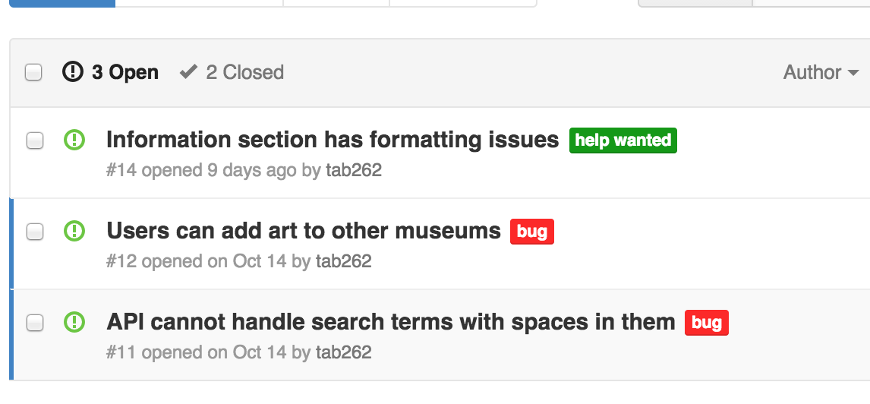
Project Management
Quality Metrics:
Fault Profile: Bugs and defects recorded on GitHub
Breadth of testing: test all functionality.
Some recorded bugs on GitHub.
Notes:
As you can see here we have a few of the reported issues on Github. We tended to do this only for major issues.
The direct communication worked fairly well, but as one might guess has some drawbacks - that is Chethan would ask we to change something in the API and most of the time I would get it down within the hour, but other times I would be busy and it might take a gentle reminder a couple days later to get me back on track,

Slide 38
Project Management
Achievements:
Delivering a project with all the features we promised our ‘customer.’
We all learned new techniques and even learned to program in new platforms and environments
Worked efficiently as two separate teams
Notes:
Our group took on what we felt would be a useful tool for the non-profit sector. Given its nature, it required us to not only create a web application, but also an Android application as well. These are not overlapping technologies and required very different sets of tools to be learned. Given this, we ended up spending a lot of time on implementation. We have accomplished most of our goals and we learned an incredible amount in the mean time. We all took this class not just become better programmers, but to become better at software development in a group setting. In the end we got a product we are very happy with, but there are some things we could have done better.

Slide 39
Project Management
Challenges and Lessons learned:
Remembering to log bugs and defects, especially small ones.
Version control, different working environments and integration
Database schema changes
Notes:
With the focus on implementation, we could have put a stronger focus on testing and quality metrics. This, admittedly, is not the most exciting part of coding, but it is necessary given the complexities of software. Much of the testing we did was manual, as it seemed sufficient enough for what we were trying to accomplish. When things broke, we tended to fix them on the fly. This was necessary because each team, Front and Back end was treating each other like a client. If the API went down, then the Android app failed to work. If the Android app failed, then the backend couldn't see how to design the models and hosting details.
The second biggest challenge we faced was dealing with group members working on different platforms and version control. Setting up the environments for both Django and Android were challenging. Django is fairly easy to setup, but running it with the Heroku server and Amazon server made centralizing the changes a bit challenging. In retrospect we have made this a priority at the beginning as it would have allowed us to work more efficiently.

Slide 40
Demo

Slide 41
Thank you!

